Slide 1
namespace Freddie Sackur { public interface ITalk { void SetLength(int length); string Waffle();

Slide 2
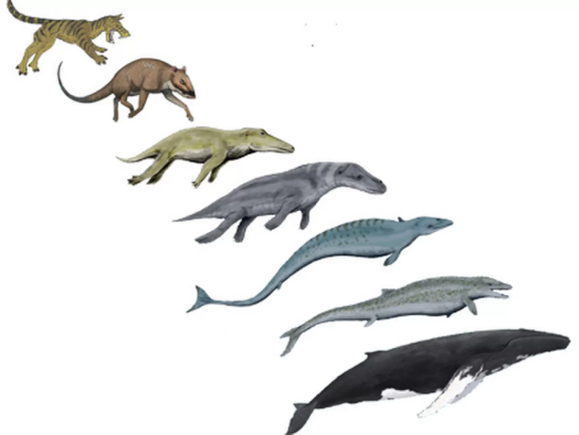
Software Engineering

Slide 3
Assembly code
CP, ADD, MOV, JMP, etc
No distinction between data and instructions
No type-checking
No exception mechanism
Imagine the bugs!

Slide 4
C
Data types and data structures
Functions - this makes it procedural in addition to being imperative
Typed - but weakly enforced
Pointers, not references - you can perform arithmetic, you may fail to initialise a pointer
Compiled - compiler checks syntax

Slide 5
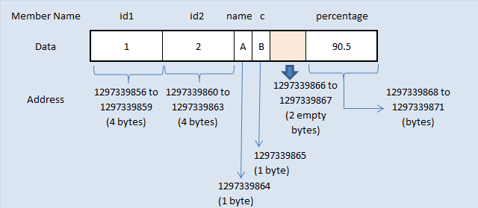
Struct

Slide 6
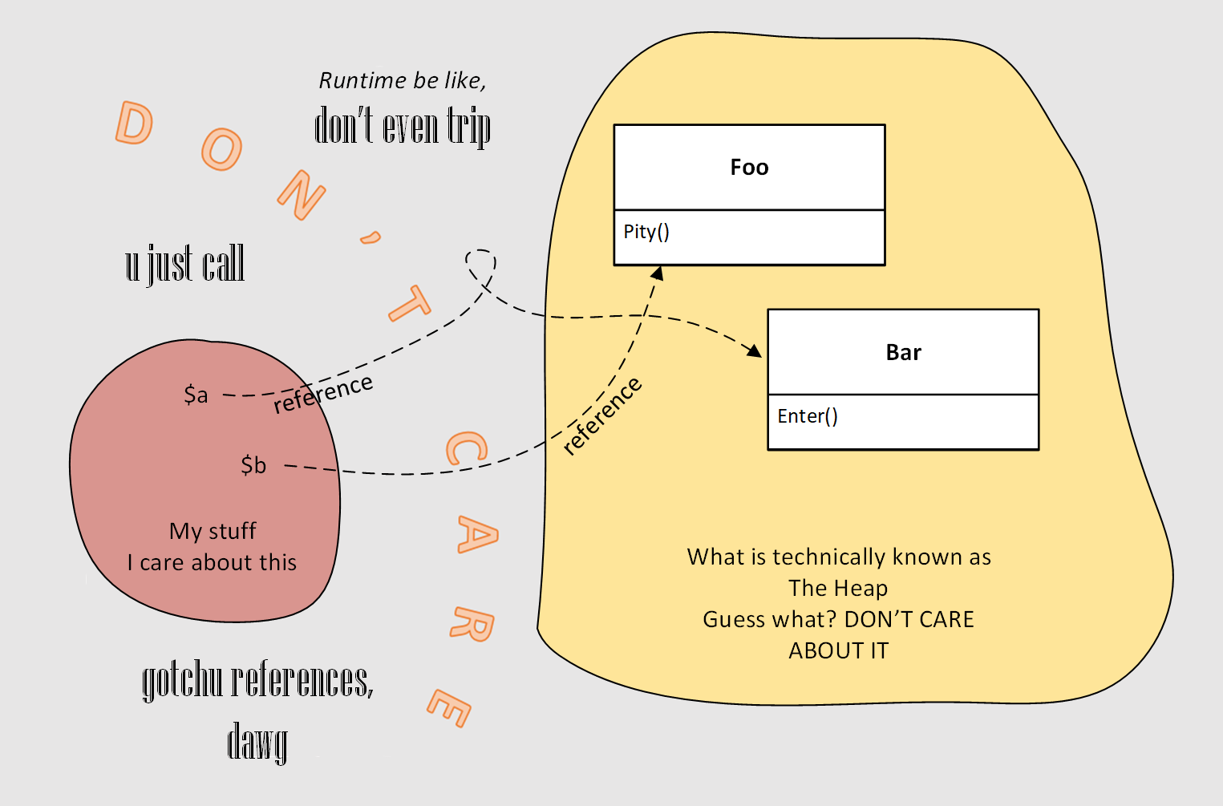
Memory managed objects

Slide 7
Java / C#
Completely memory managed - runtime handles pointers, programmers never touch them; garbage collector
Object-oriented (but allow procedural programming)
Introduce encapsulation: private, protected modifiers
Compiled: compiler checks syntax and static typing

Slide 8
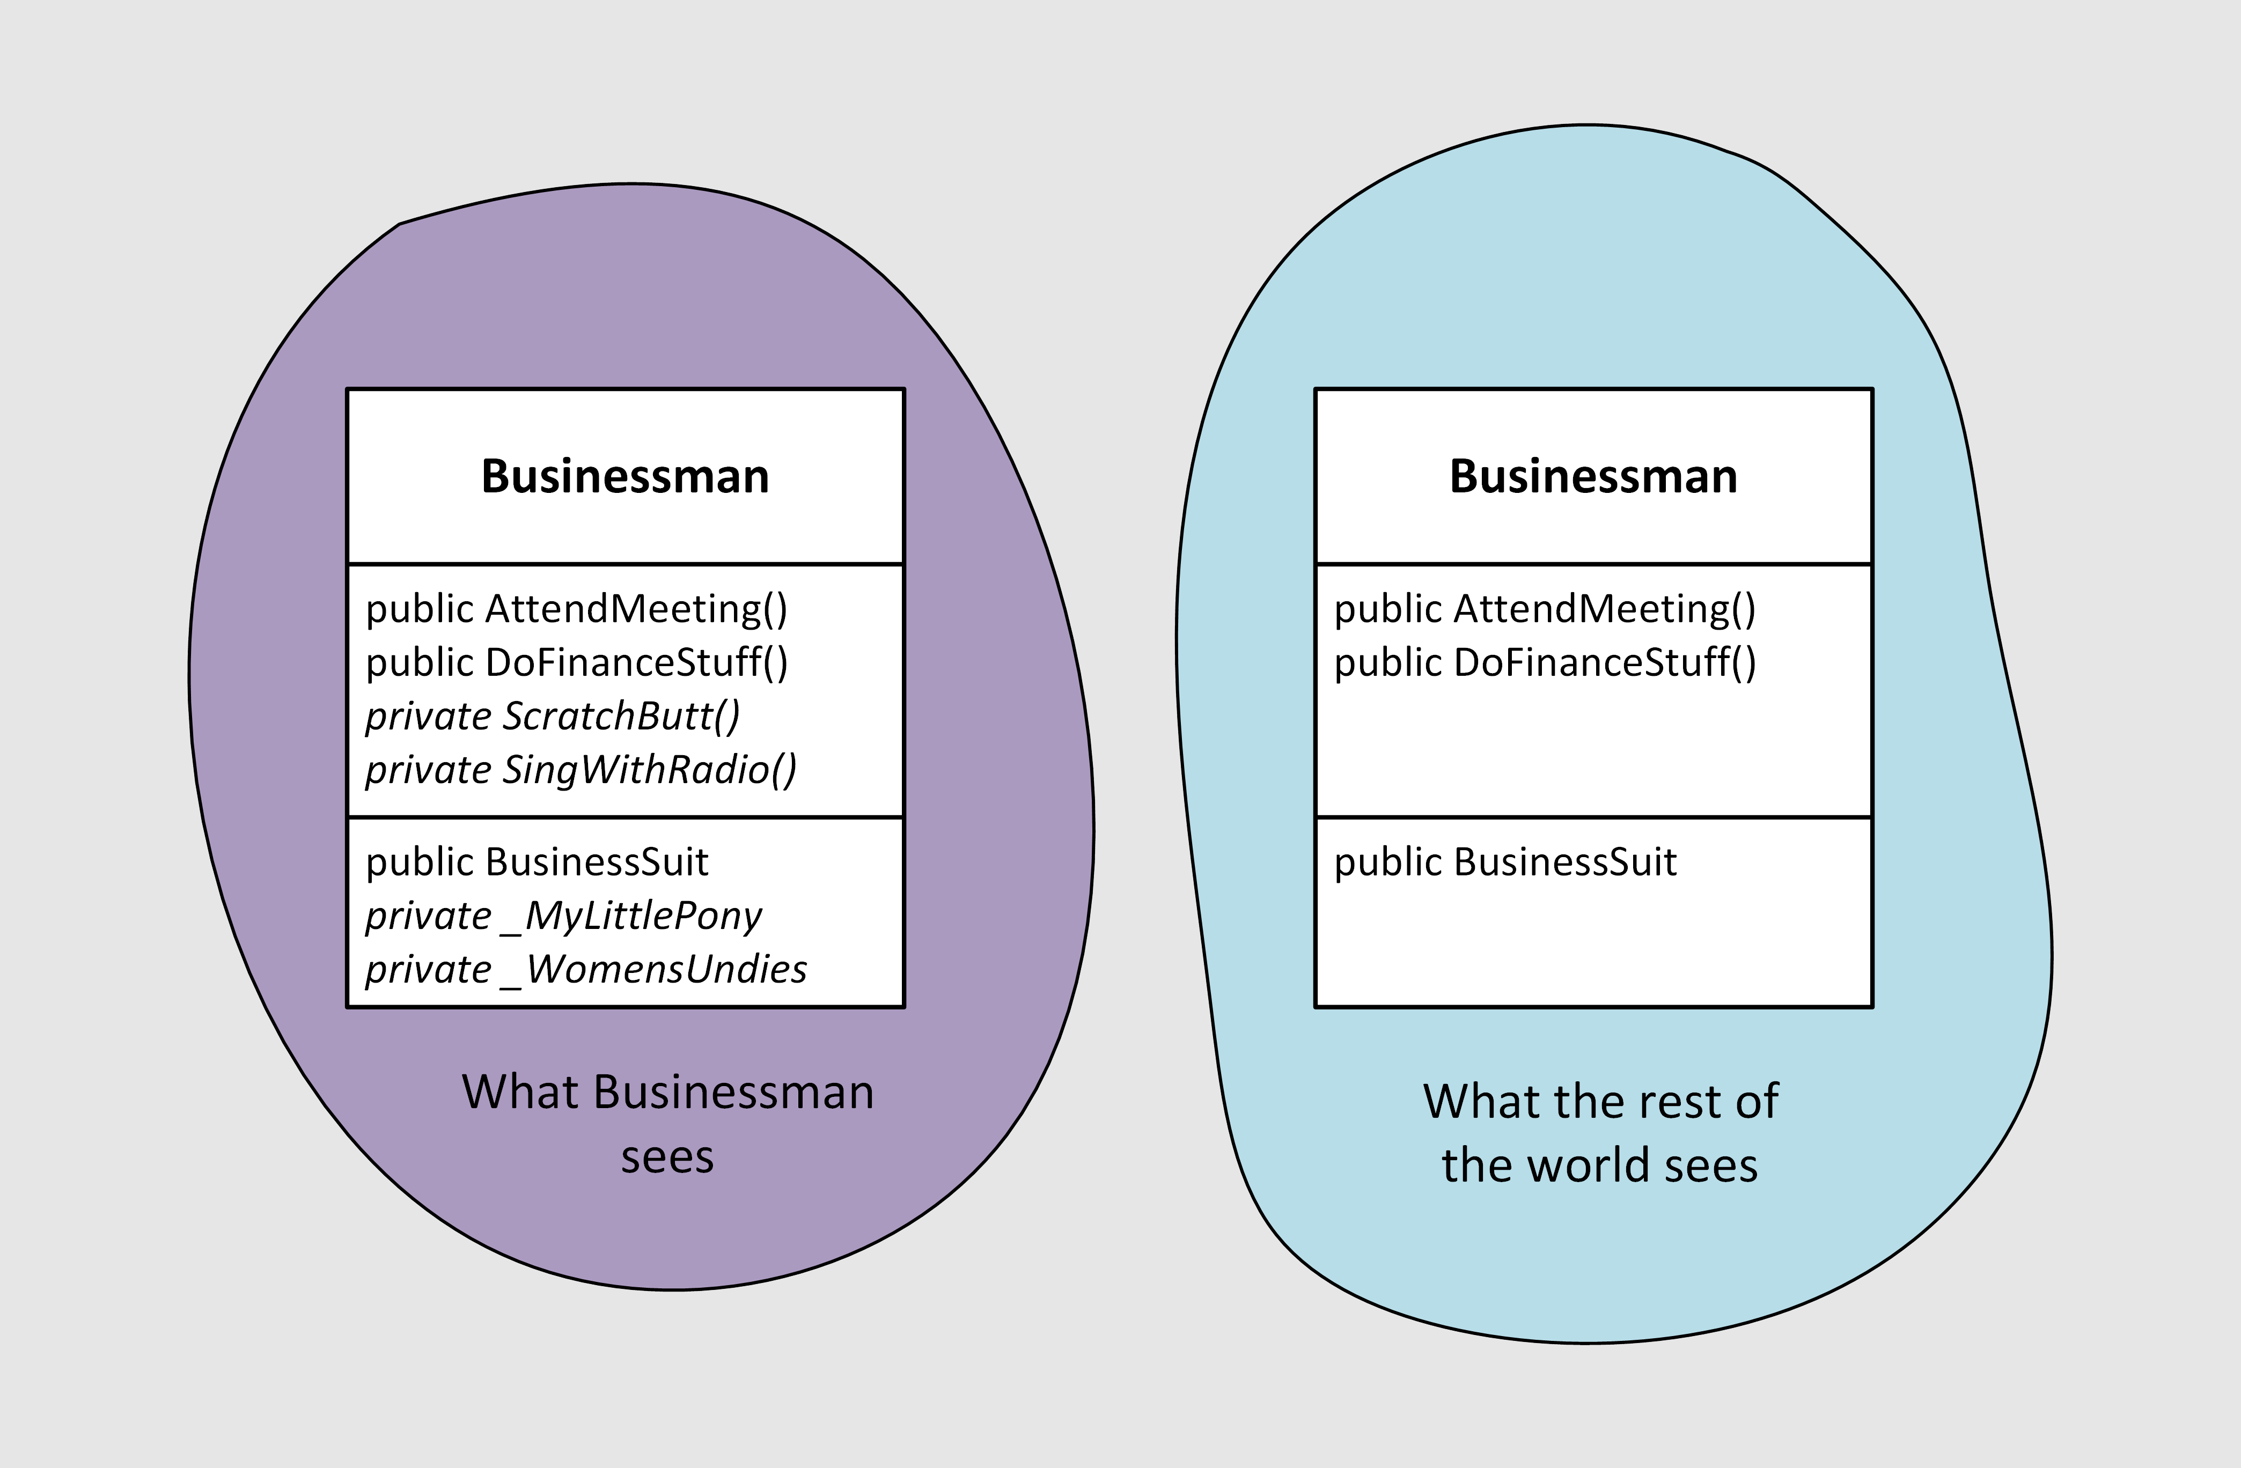
Access modifiers

Slide 9
Code to an interface, not an implementation
Get in the mindset of interacting only through carefully-designed interfaces

Slide 10
DSC / YAML / SQL
Declarative
Syntax is very constrained – you don’t think about design
Except SQL, which you can hear about in some other talk!

Slide 11
LISP / R / F#
No mutable values! Eliminates bugs caused by something being changed when you don't expect it to have been
A function is an operation that maps a domain of input values to a range of output values
That’s about it, but it turns out to be sufficient to write applications
Problem: converts are a little bit too zealous.

Slide 12
Procedural vs OOP
Procedural:
Principal control mechanism: loops and conditionals
No strong concept of access control (private members)
OOP:
Principal control mechanism is polymorphism
Stuff can be private: strong concept of interfaces

Slide 13
…Powershell
Primarily used as a procedural language (define functions and pass in data)
Can use as OO language
Custom objects
Classes in PSv5
Inline C# in any version
Use existing .NET objects
Import-Module –AsCustomObject
Weakly-typed, but you can constrain (no compiler help tho!)
Dynamically-typed
Scoped and memory-managed

Slide 14
Software Engineering
Changing requirements
Reqs not initially clear
Write software that supports future change

Slide 15
Design patterns
In software engineering, a software design pattern is a general, reusable solution to a commonly occurring problem within a given context in software design. It is not a finished design that can be transformed directly into source or machine code. It is a description or template for how to solve a problem that can be used in many different situations. Design patterns are formalized best practices that the programmer can use to solve common problems when designing an application or system. https://en.wikipedia.org/wiki/Software_design_pattern

Slide 16
Don’t Repeat Yourself (DRY)
If you’re repeating a lot of code, it’s a sign that you’re doing it wrong!

Slide 17
Separation Of Concerns
An object (or function) should only do one thing

Slide 18
Classes should be loosely coupled
Accessing many different properties or methods from one class in another class is a code smell
Best is when two classes don’t touch each other at all

Slide 19
Liskov Substitution Principle aka Polymorphism
Any object should be possible to substitute with a subclass of itself (you can use a subclass in place of a base class)

Slide 20
Strategy pattern
An object’s behaviour doesn’t come from itself, but from another object that the first object has. The Strategy object can be replaced with another to change behaviour.

Slide 21
Dependency Injection (DI) pattern aka Inversion Of Control (IOC)
Objects or services that an object needs are provided to it by a client. This gives control back to the client.
Often found with the Strategy pattern.

Slide 22
You Ain’t Gonna Need It (YAGNI)
Don’t get carried away too soon

Slide 23
Refactoring
The process of changing code, without changing the functionality, to make it better organised.
Refactor occasionally to:
keep the code clean
maintain the fitness of the architecture

Slide 24
Recap
We thought about what kind of change we might have to support
We came up with an architecture that supports that change
We separated the concerns
We implemented the variant behaviour as a Strategy object
We injected our strategy object into our main object (the function)
We equipped our tree structure with methods to both format and to get an import order
We have a clear path forward for Github / NuGet

Slide 25
Appendix
Some other design patterns

Slide 26
Adapter
Wrap one object with another to make it compatible with something else

Slide 27
Facade
Provide a simpler interface to something complex

Slide 28
Proxy
Use a placeholder to manage access or handle remoting

Slide 29
Iterator (aka Enumerator in .NET)
Provide a collection-agnostic way to step through items in a collection
Notes:
This pattern includes:
A way to get the current item
A way to move to the next item
A test whether there are any more items left to go

Slide 30
Decorator
Warp an object with another of the same interface, to expand on the original object’s functionality
Notes:
Also see: Compound

Slide 31
They’re more like guidelines…
You can break a principle if you have a good reason
Notes:
Don’t be too rigid about adhering to principles or using patterns.

Slide 32
Further reading
https://dfinke.github.io/powershell,%20design%20patterns/2018/04/13/PowerShell-And-Design-Patterns.html
https://www.automatedops.com/blog/2018/04/11/software-design-patterns-in-powershell-strategy-pattern/
Design Patterns (Gamma/Helm/Johnson/Vlissides) (Gang Of Four)
https://en.wikipedia.org/wiki/Design_Patterns
Head First Design Patterns (Freeman/Robson/Bates/Sierra)
Patterns Of Enterprise Application Architecture (Fowler)
Shameless plug: https://blog.dustyfox.uk

